Slide 1
OPEN CV
Given a CCTV camera video, detect persons

Slide 2
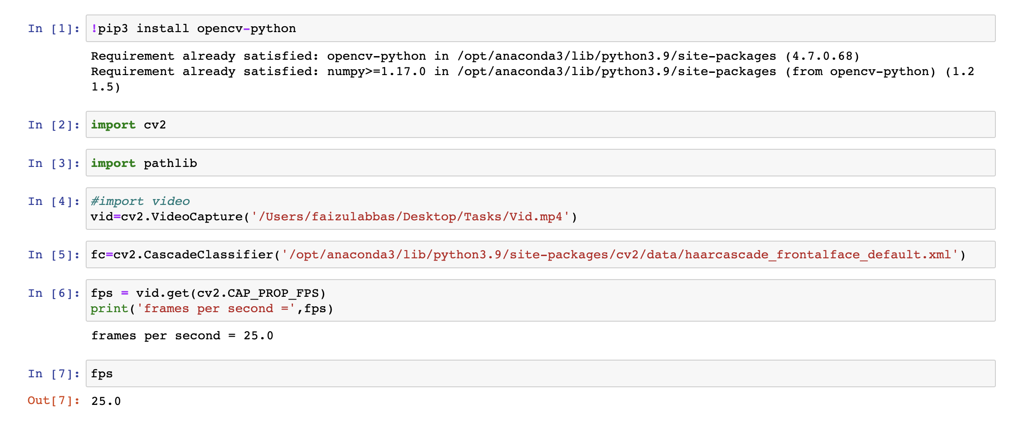
Opening a video with OpenCV
First of all install library open CV for computer vision Programming

Slide 3
How to get data
Like image data, video data may contain all sorts of additional information or metadata other than the image frames themselves such as data created, and information about the capture device and other technical information. If we want a frame from a particular point of a video an important piece of information we can use is the numbers of frames per second, or fps. To get this information from a video in OpenCV we need to use the variable CAP_PROP_FPS and the function get as follows:
fps = vid.get(cv2.CAP_PROP_FPS) print('frames per second =',fps)
Fps=25 (calculated)

Slide 4
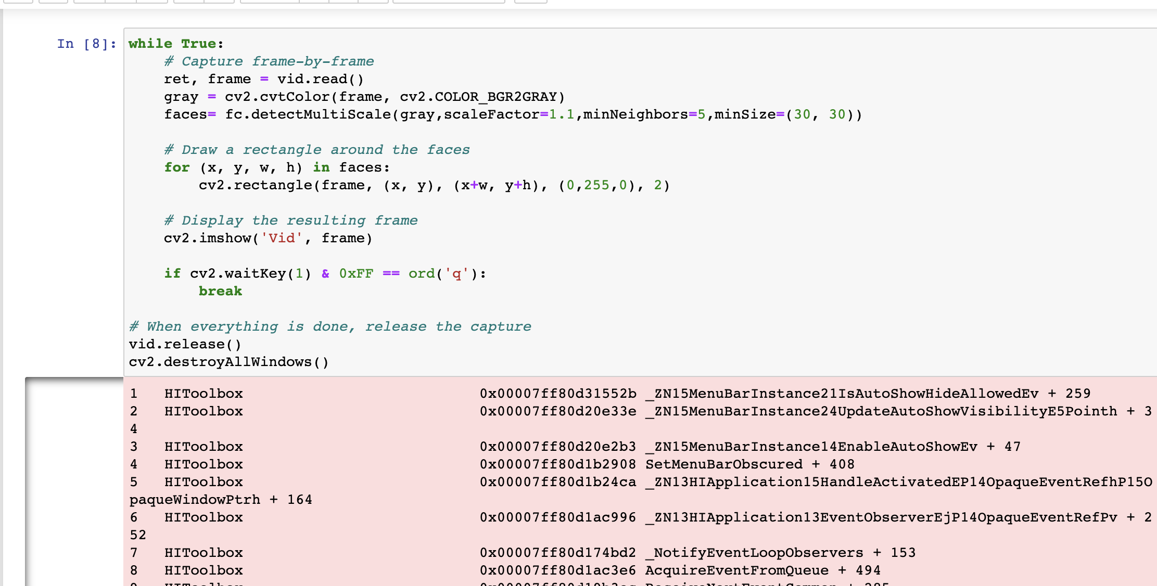
Capture frame by frame

Slide 5
Finding the frame at a particular time
As we know, video consists of a finite set of discrete image frames. These are ordered and can be found by the frame number. If we know the number of frames per second, and the time in the video we want to take a frame from, we can easily calculate the frame number we want.
minutes = 0 seconds = 28 frame_id = int(fps*(minutes*60 + seconds)) print('frame id =',frame_id)
This tells us that for 0 minutes 28 seconds into the video we need frame 700. The int() around the calculation makes sure the result we get is an integer value, since the that’s what we need to find a specific frame.

Slide 6
Basic Concepts and Approaches
Now we create the cascade and initialize it with our face cascade. This loads the face cascade into memory so it’s ready for use. Remember, the cascade is just an XML file that contains the data to detect faces.
This function detects the actual face and is the key part of our code, so let’s go over the options:
The detectMultiScale function is a general function that detects objects. Since we are calling it on the face cascade, that’s what it detects.
The first option is the grayscale image.
The second is the scaleFactor. Since some faces may be closer to the camera, they would appear bigger than the faces in the back. The scale factor compensates for this.
The detection algorithm uses a moving window to detect objects. minNeighbors defines how many objects are detected near the current one before it declares the face found. minSize, meanwhile, gives the size of each window.

Slide 7
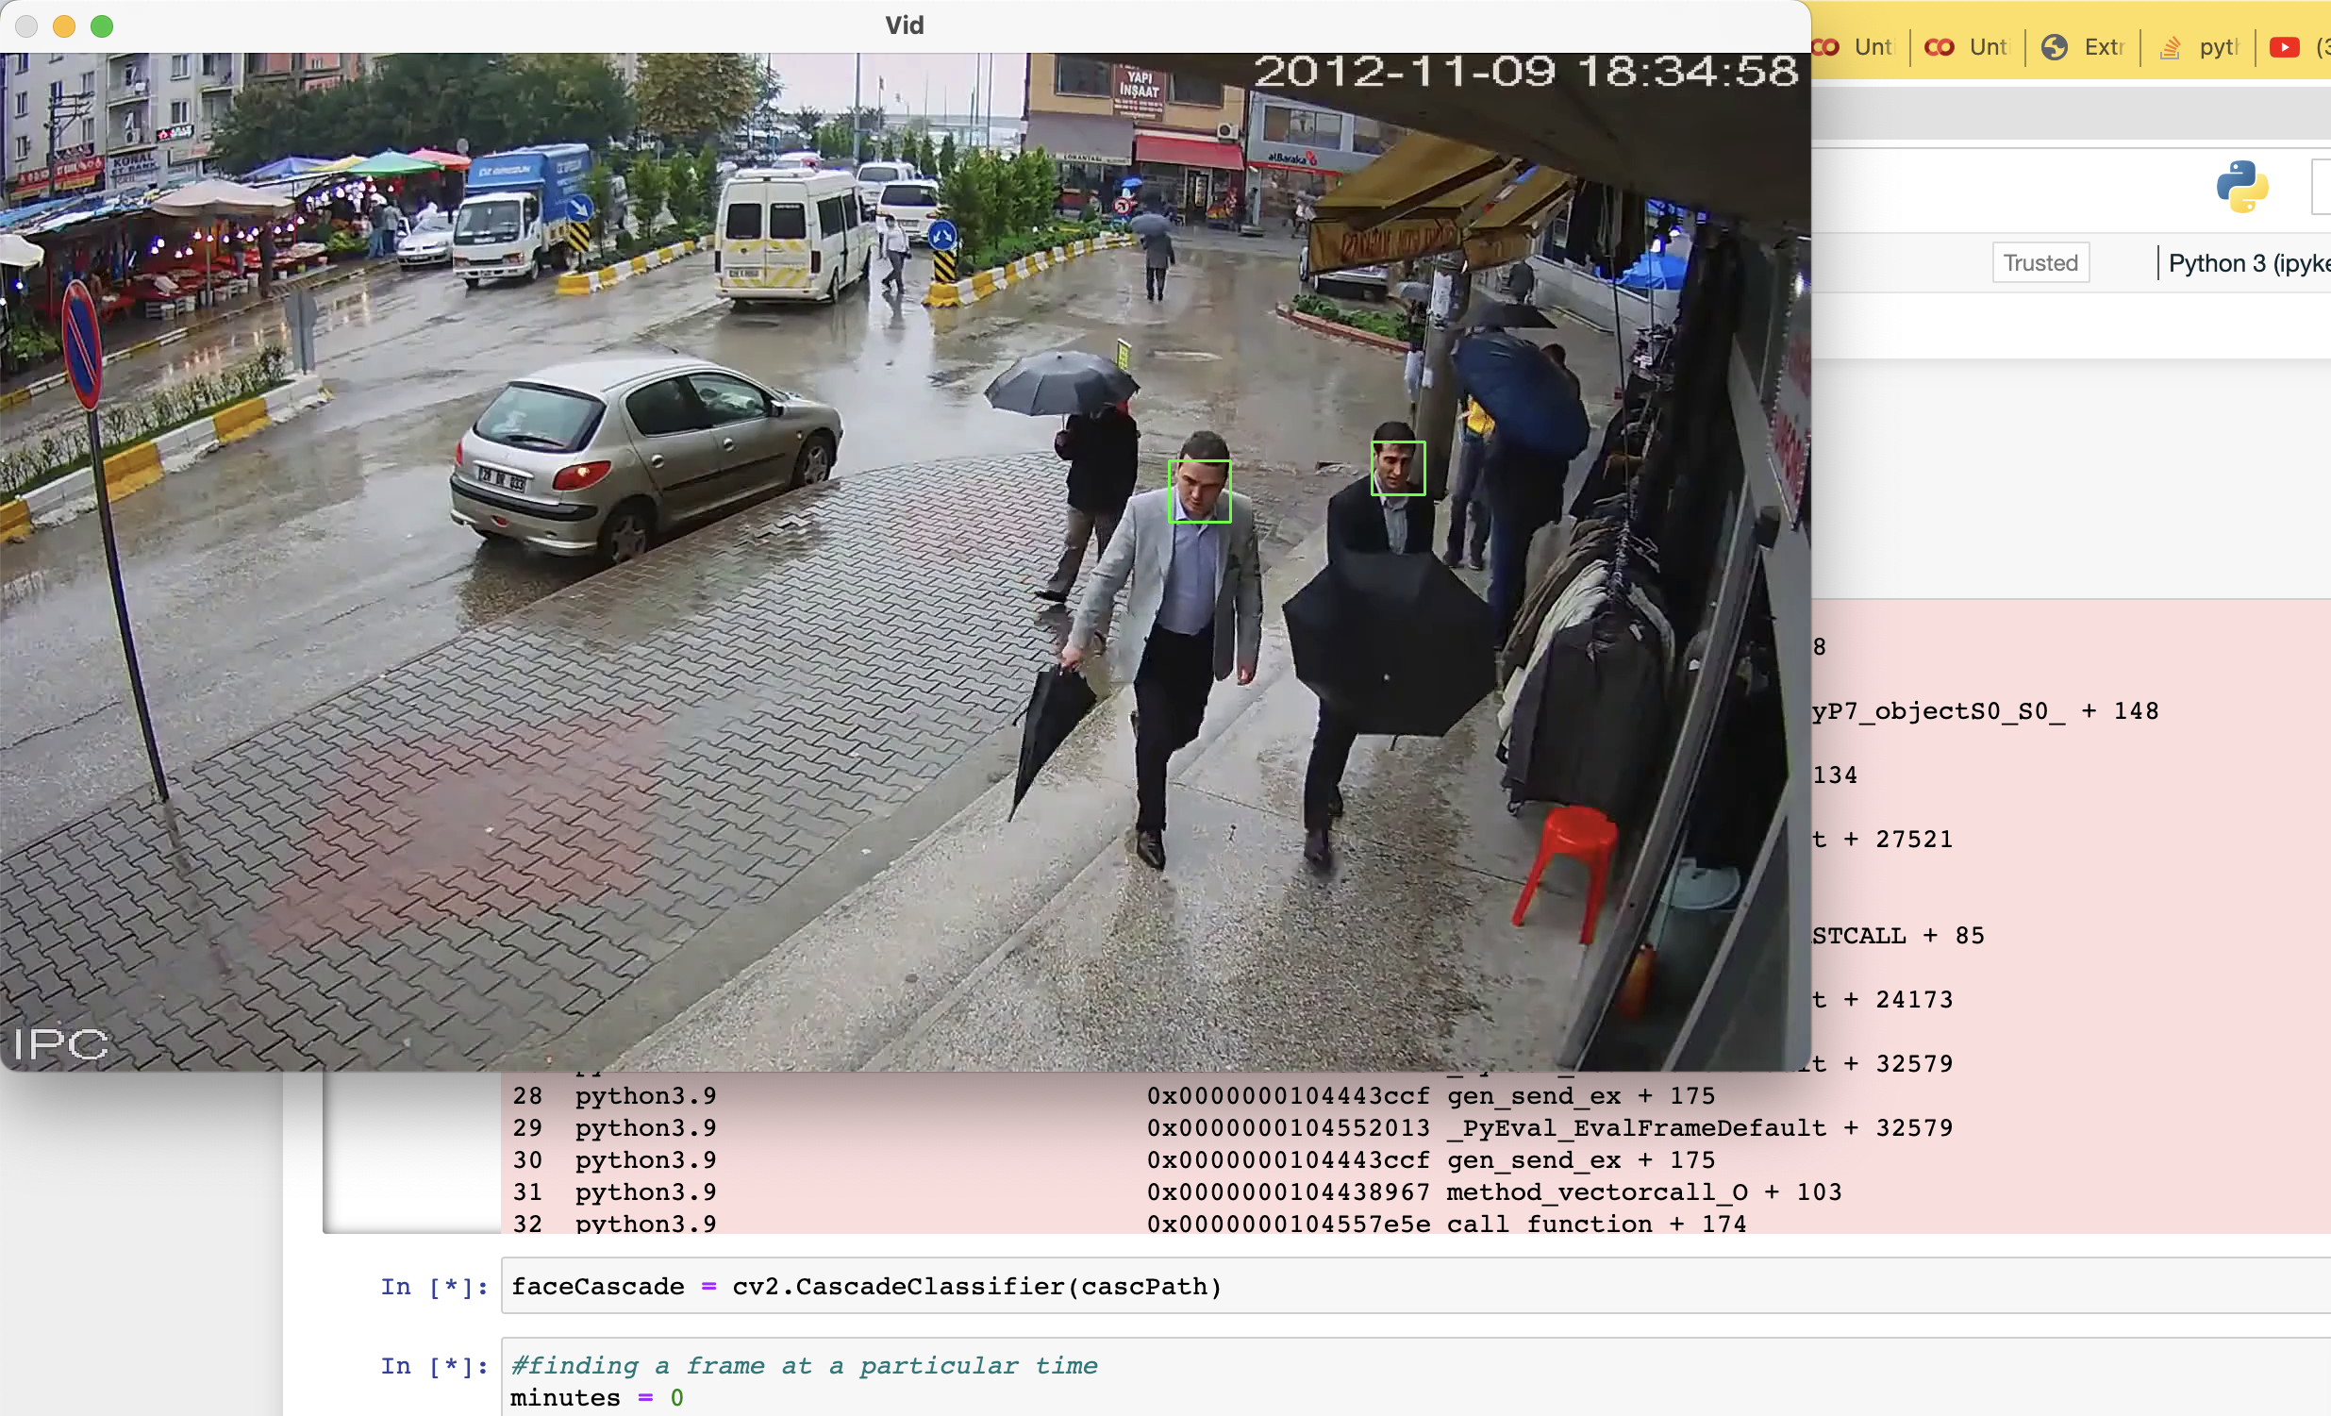
Face Detection

Slide 8
Submitted by – Syed Faizul abbas
Thank you so much for giving this opportunity to learn .

